Slide 1
CSE2002 Theory of Computation and Compiler Design
MODULE - 4
Dr. WI. Sureshkumar
Associate Professor
School of Computer Science and Engineering (SCOPE)
VIT Vellore
wi.sureshkumar@vit.ac.in
SJT413A34

Slide 2
Augmented grammar
If G is a grammar with start symbol S, then G’, the augmented grammar for G, is G with a new start symbol S’ and production S’ → S.
If G = (N, T, P, S), then G’ = (N U {S’} , T, PU {S’ → S} , S’)
The purpose of this new starting production is to indicate to the parser when it should stop parsing and announce acceptance of the input.

Slide 3
LR(1) Items
Let G = (N, T, P ,S) be a CFG.
[ A → w₁ . w₂ , u ] is called LR(k) item if A → w₁ . w₂ is a production
from P, and u is a sequence of terminals, the length of which is less
or equal to k.
LR(0) items should not contain sequence of terminals i.e.,
[ A → w₁ . w₂ ]
LR(1) item is of the form, [ A → w₁ . w₂, a] where a is a terminal.

Slide 4
Closure
If I is a set of items for a grammar G, then the Closure(I) is the set of items constructed from I by the following rules:
Every item in I is added to closure(I)
If [A →α.Bβ , a] is in closure(I) and each production B → γ, and each terminal b in FIRST (βa ) such that [B → .γ, b] is not in I, do add [B → .γ, b] to I .
Repeat the step (2) until no more new items can be added to closure(I)

Slide 5
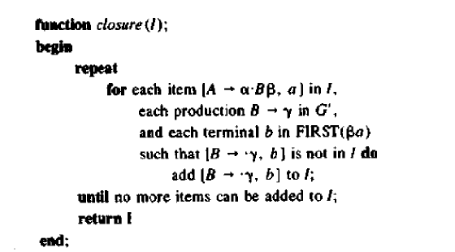

Slide 6
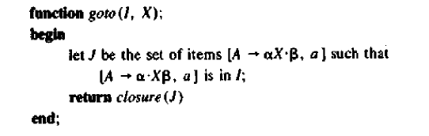

Slide 7
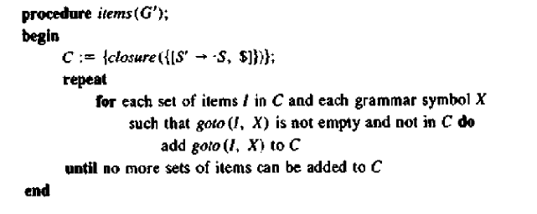

Slide 8
Example: Given grammar G
S → CC (1)
C → cC (2)
C → d (3)
Augmented grammar G’
S’ → S
S → CC
C → cC
C → d

Slide 9
Collection of Canonical LR(1) Sets of Items
I₀ : S’ → .S , $ goto(I₀ , C) = I₂
S → .CC , $ I₂ : S → C.C , $
C → .cC , c/d C →.cC , $
C → .d , c/d C →.d , $
goto(I₀ , S) = I₁ goto(I₀ , c) = I₃
I₁ : S’ → S. , $ I₃ : C → c.C , c/d
C →.cC , c/d
C →.d , c/d

Slide 10
goto(I₀ , d) = I₄ goto(I₂ , d) = I₇ goto(I₃ , d) = I₄
I₄: C →d. , c/d I₇: C →d. , $
goto(I₂ , C) = I₅ goto(I₃ , C) = I₈ goto(I₆ , C) = I₉
I₅: S → CC. , $ I₈: C → cC. , c/d I₉: C → cC. , $
goto(I₂ , c) = I₆ goto(I₃ , c) = I₃ goto(I₆ , c) = I₆
I₆: C → c.C , $ I₃: C → c.C , c/d goto(I₆ , d) = I₇
C →.cC , $ C →.cC , c/d
C →.d , $ C →.d , c/d

Slide 11
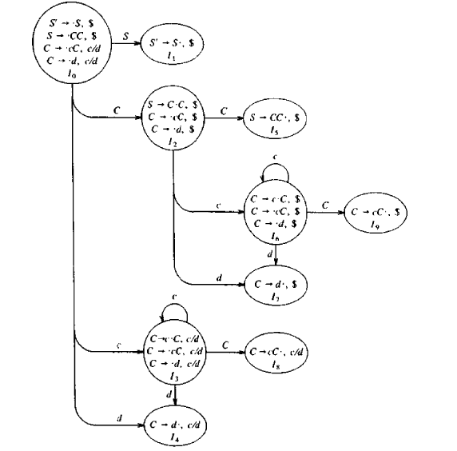

Slide 12
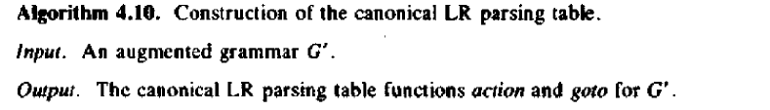
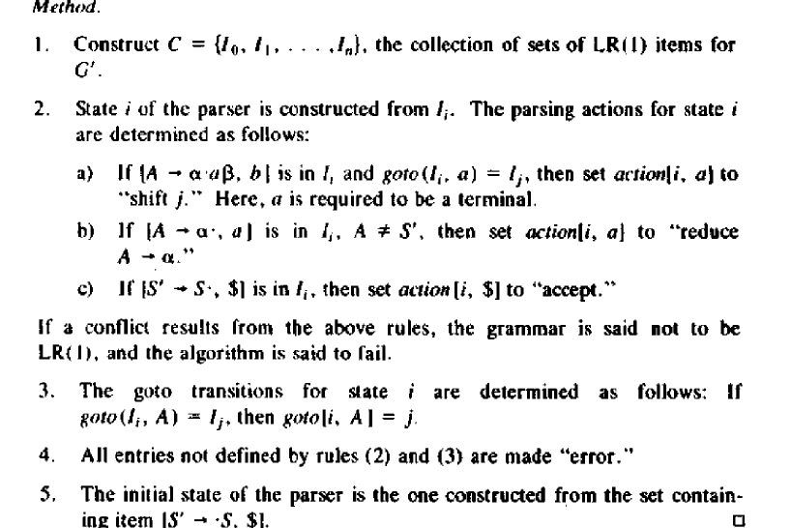

Slide 13
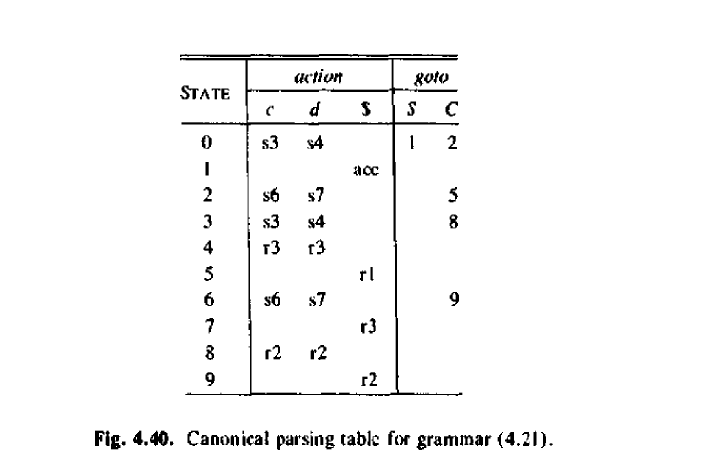

Slide 14
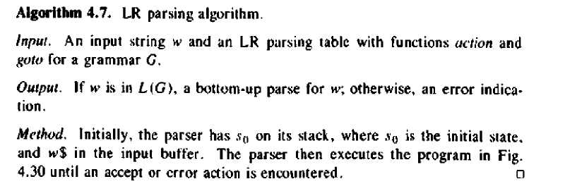

Slide 15
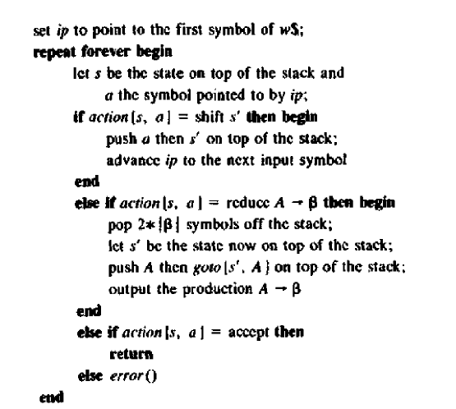

Slide 16
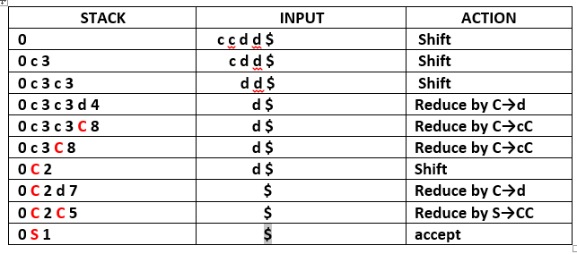

Slide 17
S
C
C
d
c
C
c
C
d

